Slide 1
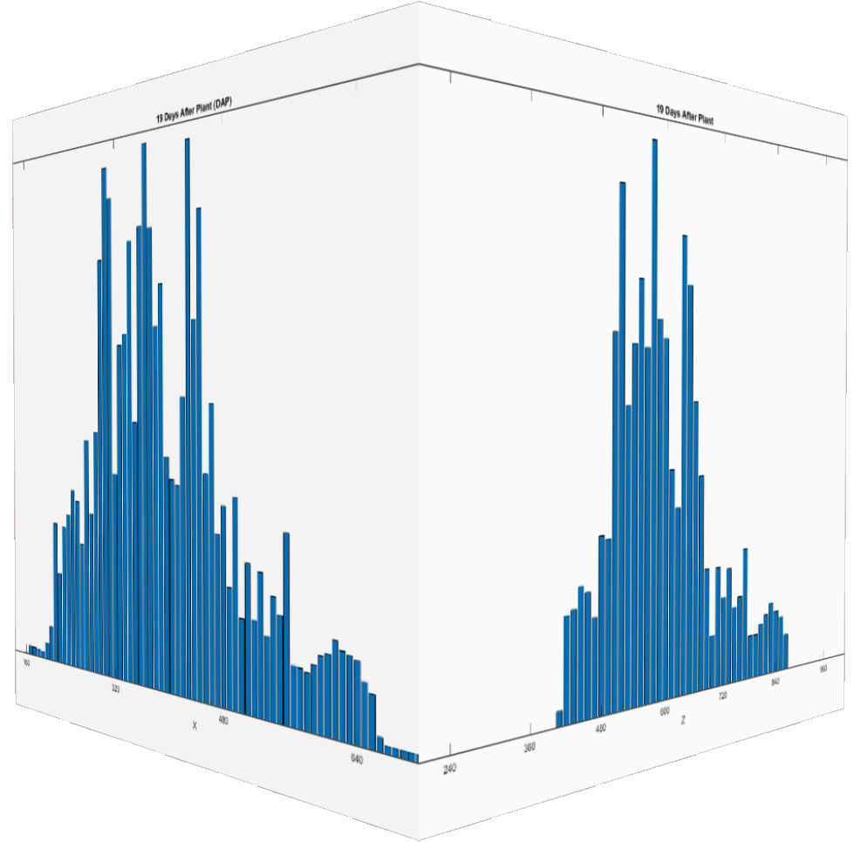
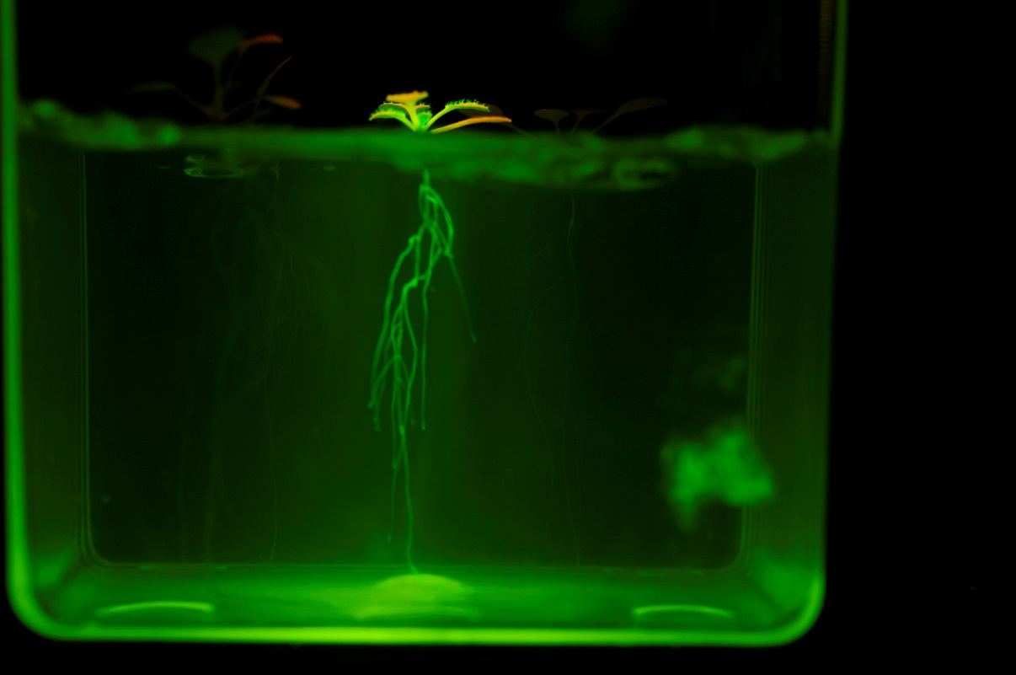
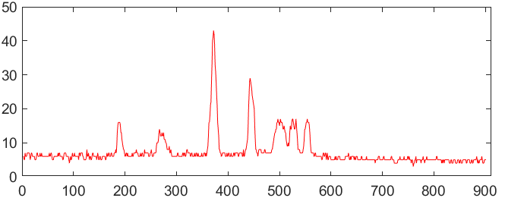
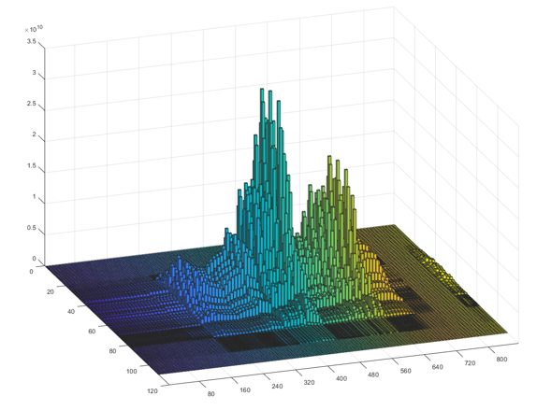
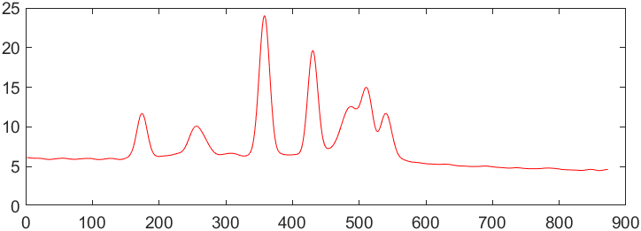
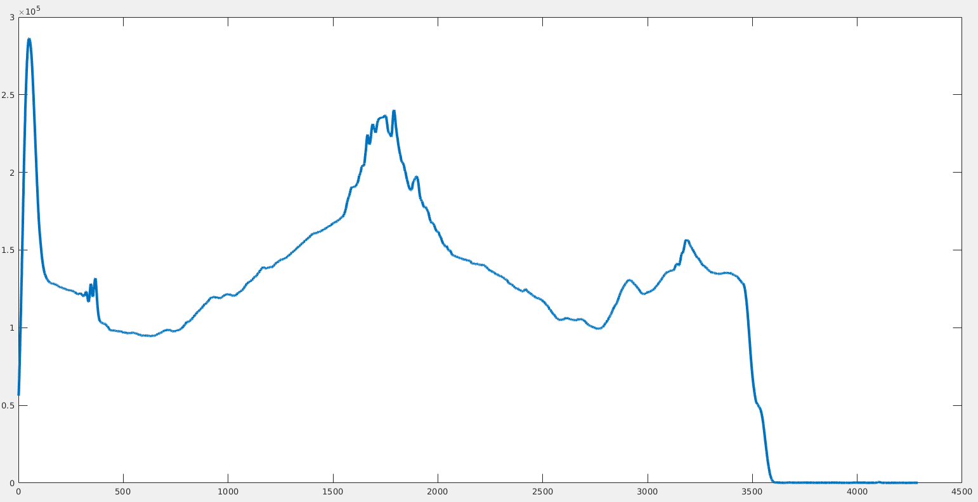
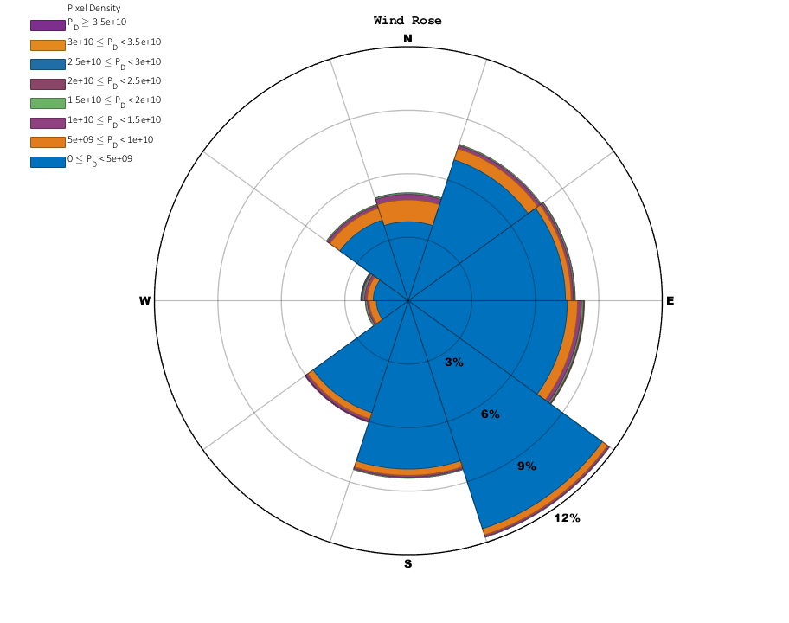
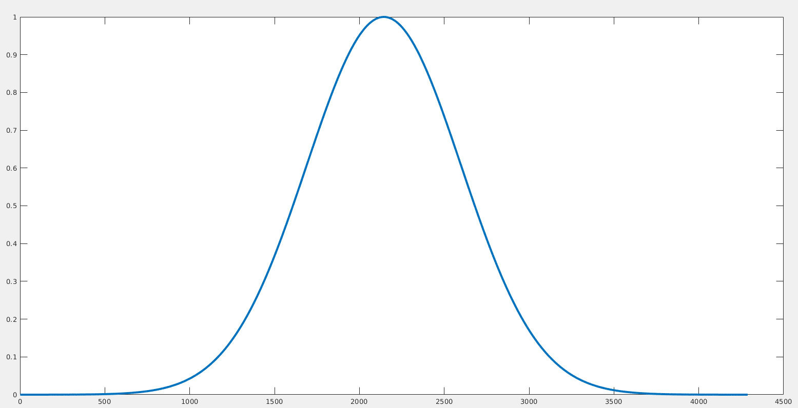
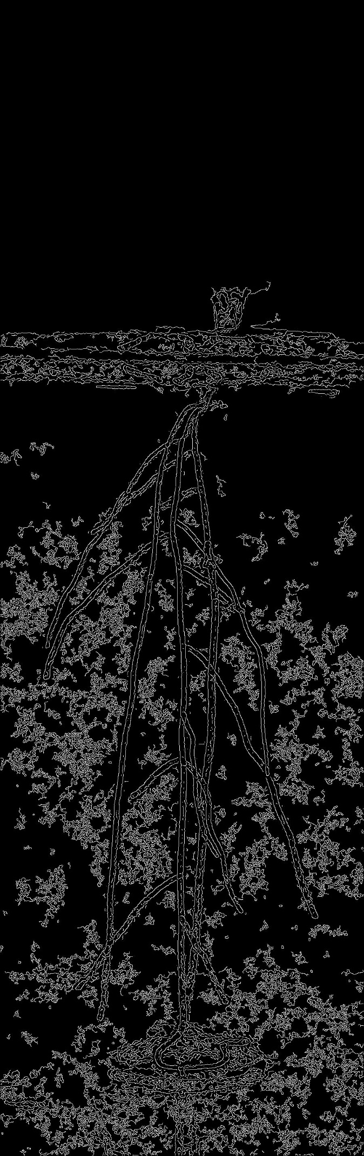
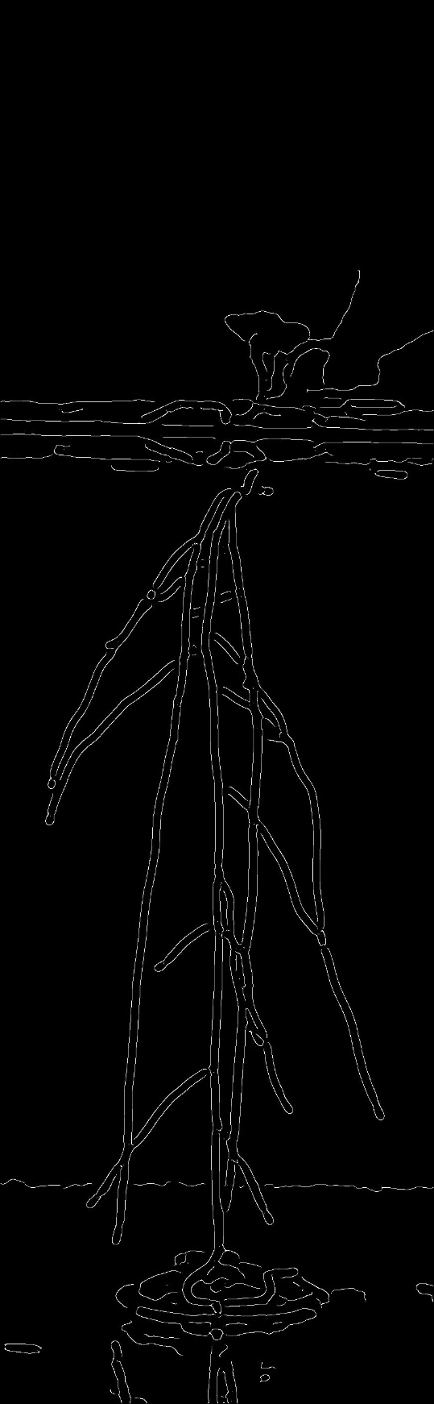
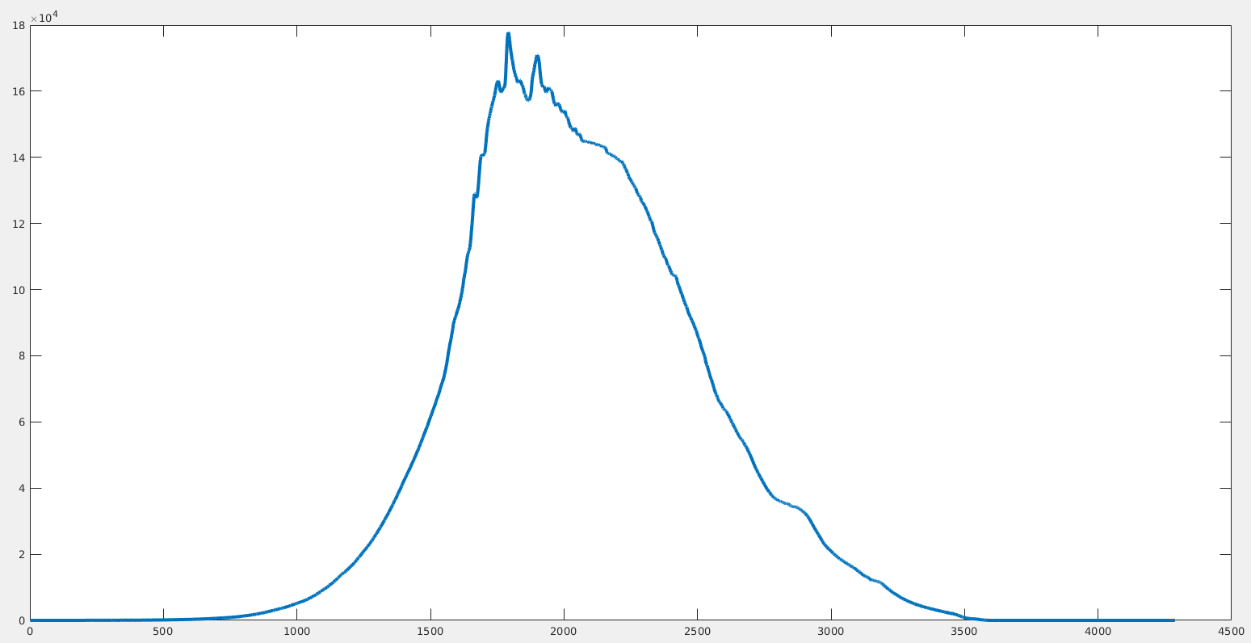
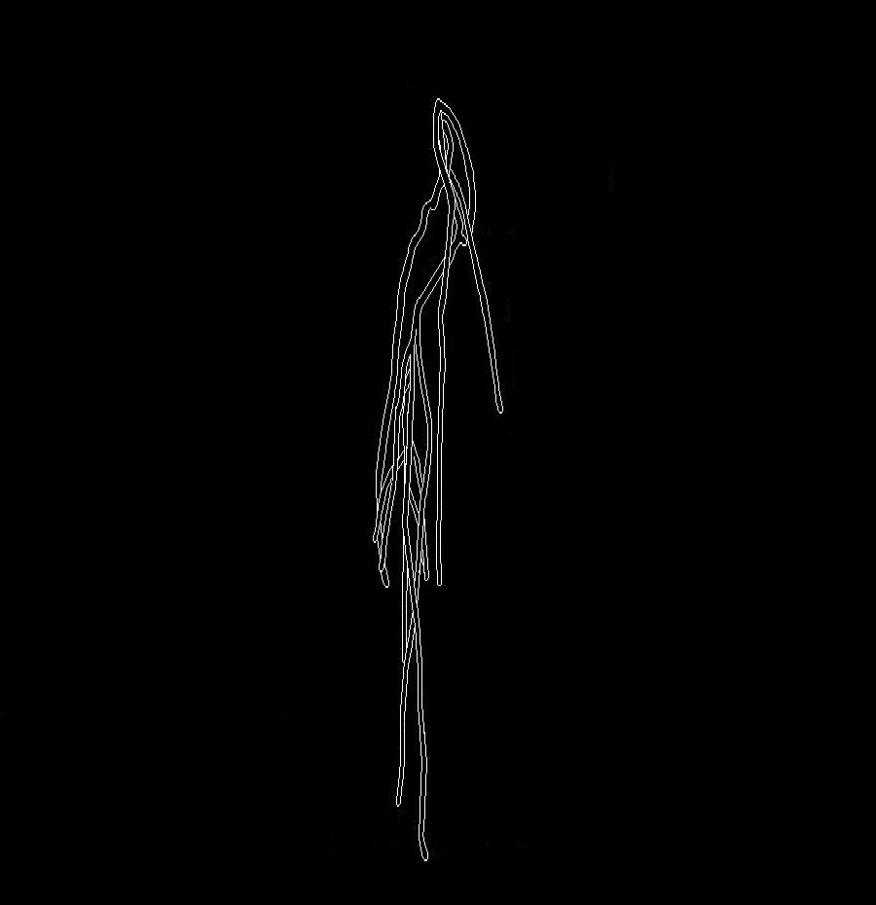
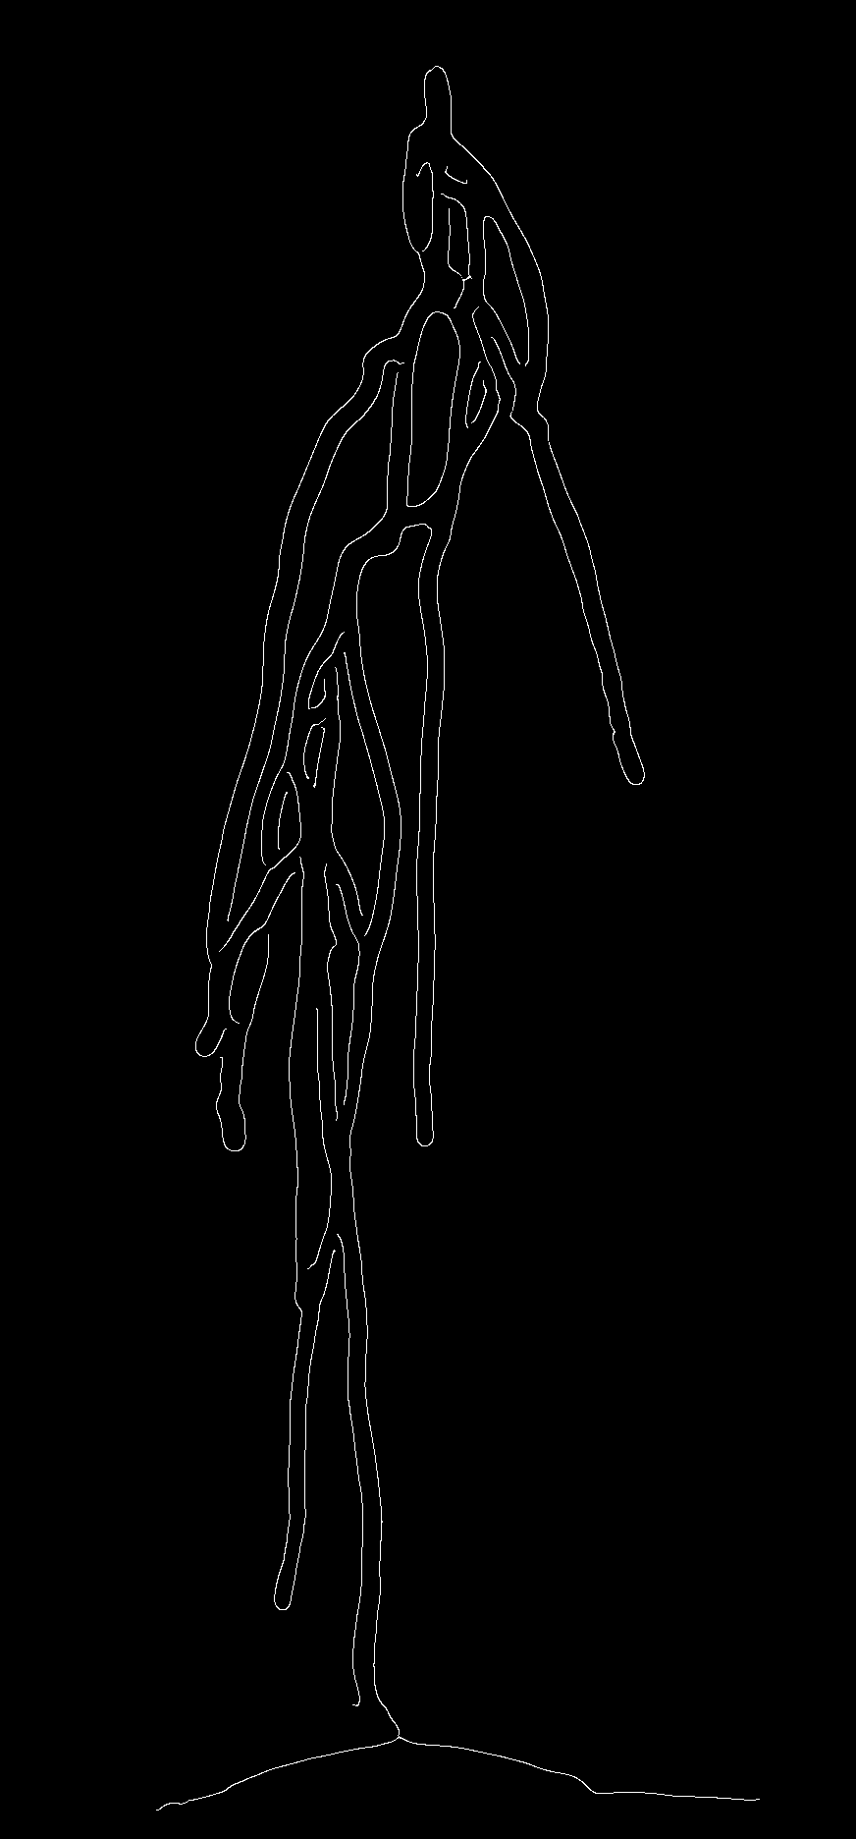
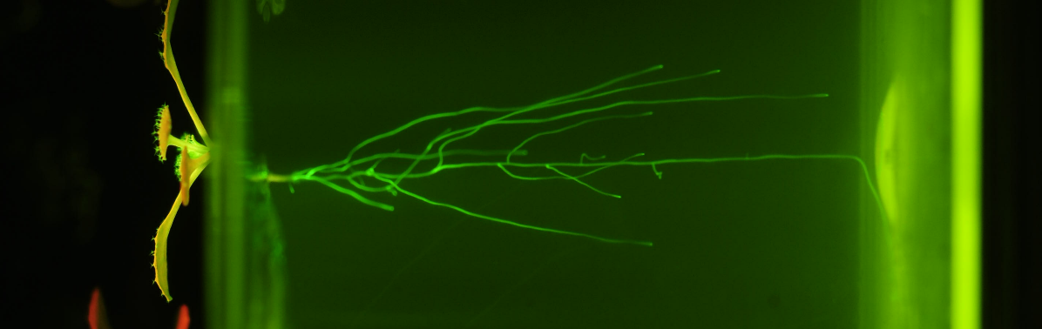
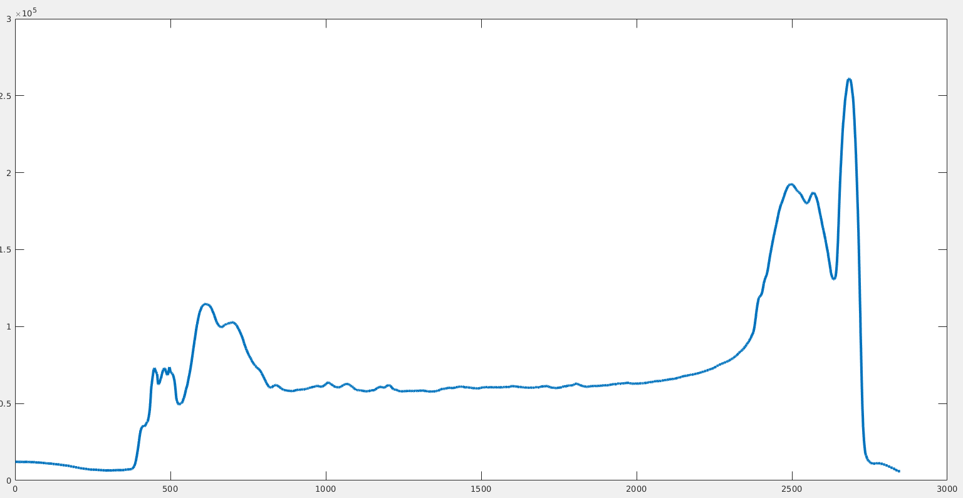
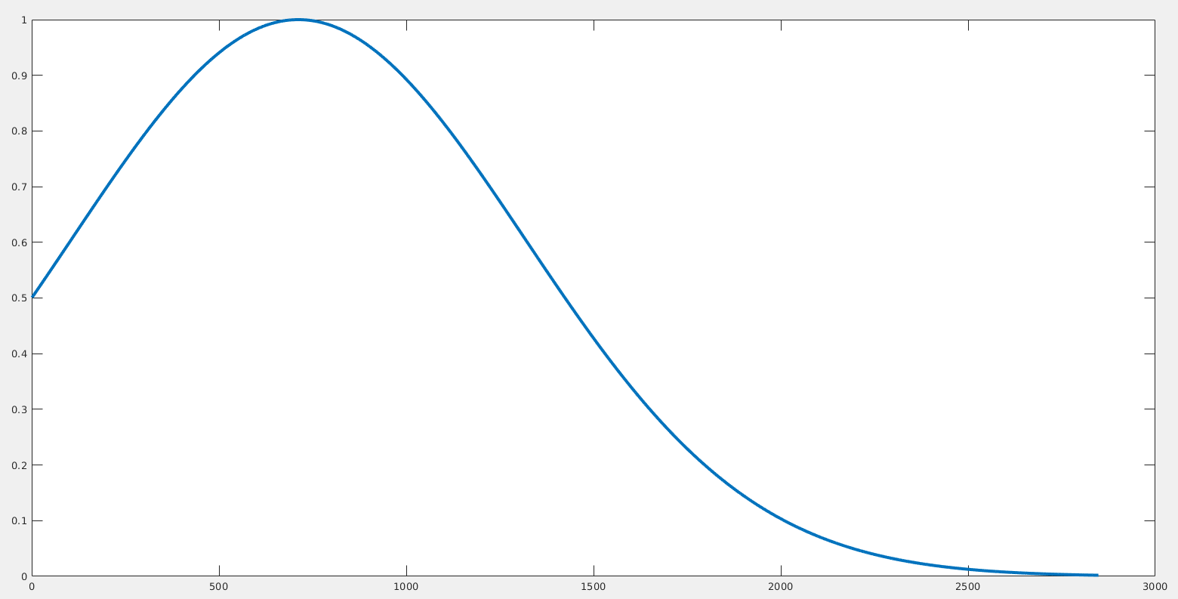
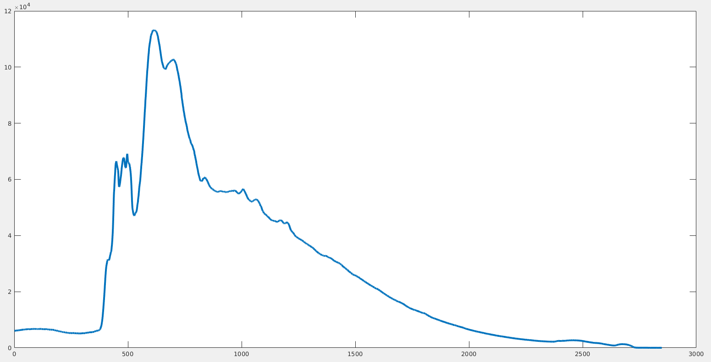


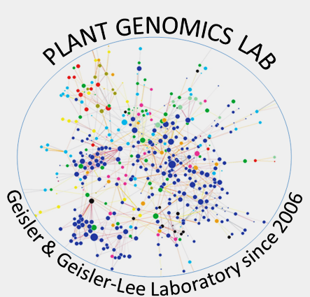
An Automated Process for the Cropping, Processing, and Analysis of Images of Root Systems
Christopher McNeil, Dalton Overmyer, Thomas Abebe
^{Department of Computer Science}
Introduction
The goal of this project is to create a more time efficient methodology to analyze root systems through the usage of automation in MATLAB. To perform analysis we need to take an unedited input images, and automatically crop it down to size, find the edge of the root, and finally perform several types of analysis. The final product will be a single streamlined process that can achieve all our objectives while performing them faster than a human can.
Objectives
Obj 1: To automatically define boundaries within the image that contain only the region of interest and to subsequently crop the image down to only that region.
Obj 2: To utilize canny edge detection to reduce the images to a binary image to allow for further analysis while at the same time maintaining image quality by filtering out noise.
Obj 3: To output several useful analyzes that can be used to draw conclusions.
Analysis and Data Interpretation
Each image is divided into 100 equally sized vertical segments.
Each segment has the number of white pixels summed
Auto-Cropper
Can be used to find skewness, kurtosis and depth.
Cropping width
Filtering and Edge Detection
Figure 5
A
A
The filter smooths jagged peaks of intensity to create a more uniform distribution
3D histogram is created using matrix multiplication of xy and zy histograms
B
The filter removes sharp contrasts leaving a smooth gradient.
Used to determine direction of root growth
B
The first step in the auto cropper is to sum the intensity of each pixel in every column of the image.
Figure 6
Figure 3
Removal of sharp contrasts results in less noise that canny can detect
Center is found using maximum value in 3D histogram
C
Intensity with and without gaussian filter
Converts cartesian coordinates of 3D histogram to polar coordinates
The second step is to create a modified Gaussian which acts as a scalar on the intensity distribution
Each sector represents pixel density of the sector relative to the center
D
The last step for finding the width bounds is to find the max and use it as the center point of the cropped image
Figure 7
Testing results
Under good conditions, output can be nearly as good as a human can do.
Good conditions include: Proper lighting, little blur, high fluorescence, in relation to the background.
Despite being nearly as good, some minimal post editing may be required.
Time required for cropping, processing, and analyzing an image is ~10 seconds on an 8 core, 4Ghz processor.
Figure 1
Cropping Height
A
The first step is to rotate the image 90 degrees
B
The next step is to sum the intensity of each column of the rotated image
A
Figure 4
B
A
Figure 7
B
Comparison of canny output with and without a filter
Comparison of human vs machine post-canny output
C
Conclusion
While unable to match the level of precision that a human can achieve, the methodology used is able to perform analysis on root systems in a fraction of the time that it would take a human. This will help to free up more time for research rather than spending time manually processing and analyzing images.
A modified Gaussian is then created to act as a scalar for the intensity graph
D
Lastly the max is found and used as the upper height of the cropped image
Literature Cited
Geisler-Lee, J.; Liu, X.; Rang, W.; Raveendiran, J.; Szubryt, M.B.; Gibson, D.J.; Geisler, M.; Cheng, Q. Plants 2017, 6, 46. doi:10.3390/plants6040046.
Daniel Pereira (2020). Wind Rose (https://www.mathworks.com/matlabcentral/fileexchange/47248-wind-rose), MATLAB Central File Exchange.
Acknowledgements
Figure 2

